Slide 1
Double Descent: Occam’s Razor’s Edge?
LAI Reading Group
3 December 2025
Rui-Yang Zhang

Slide 2
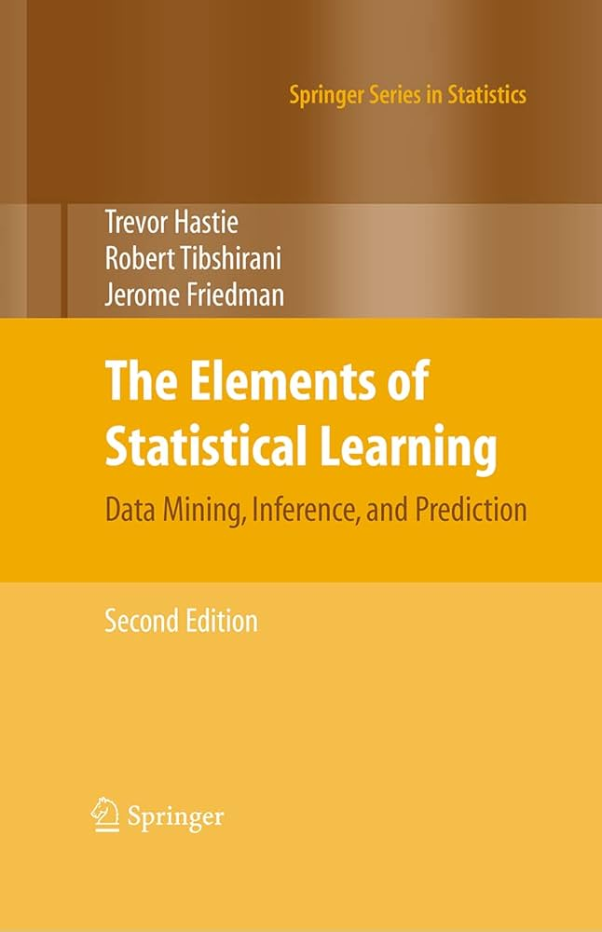
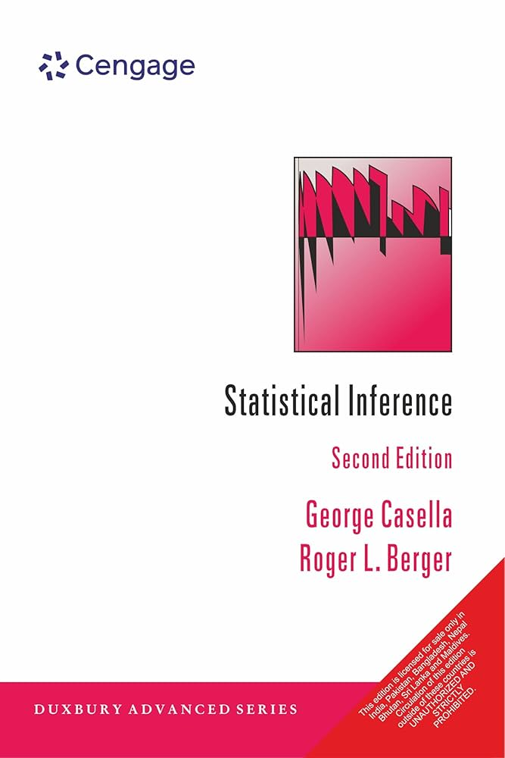
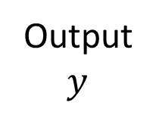
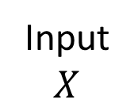
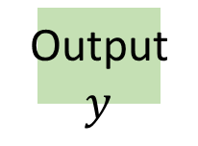
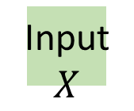
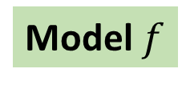
Classical Statistical Learning
Data
Exploratory Data Analysis
Feature Extraction
Input $$X$$
Output $$y$$
Model $f$
Selection & Validation
Build & Fit Models
Input $$X$$
Output $$y$$

Slide 3
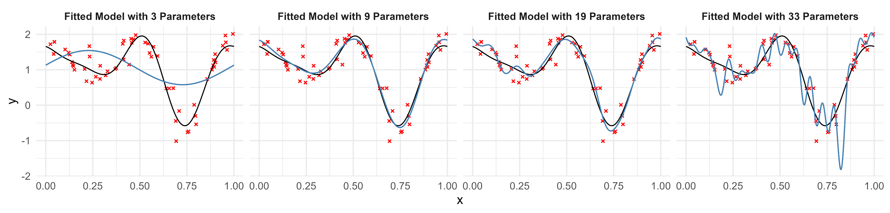
Bias-Variance Trade-off
Fourier-basis model regressions with a varying number of bases.

Slide 4
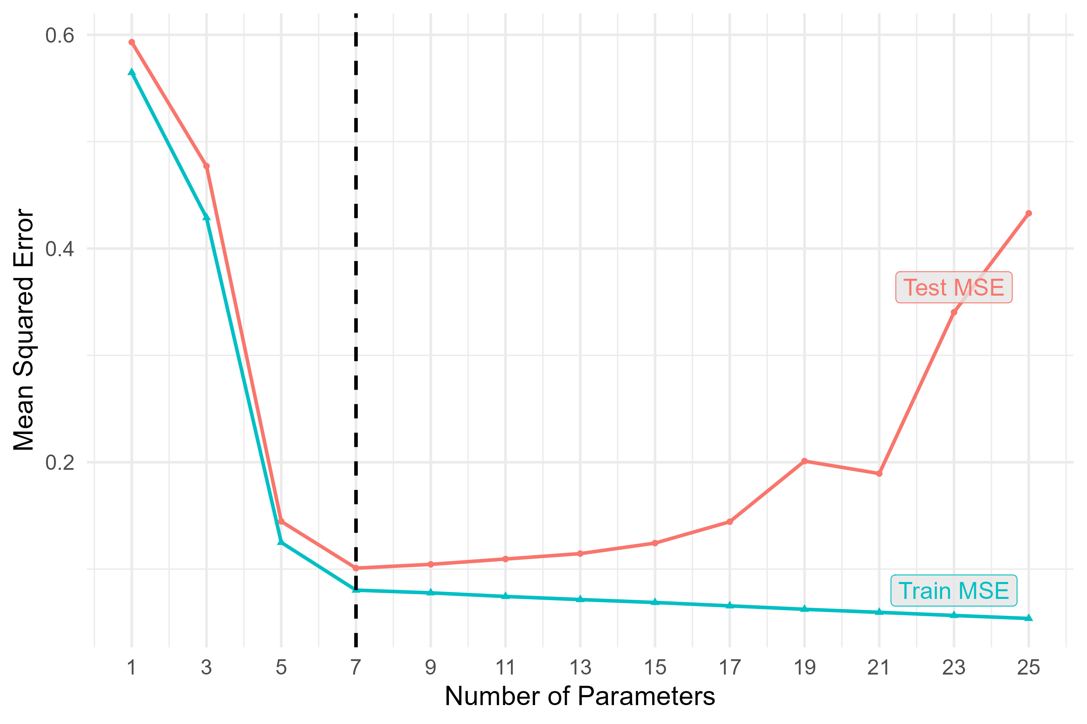
Bias-Variance Trade-off

Slide 5
Bias-Variance Trade-off
Issue: Near-zero training loss. Overfitting!
Issue: Too many parameters. Over-parameterisation!

Slide 6
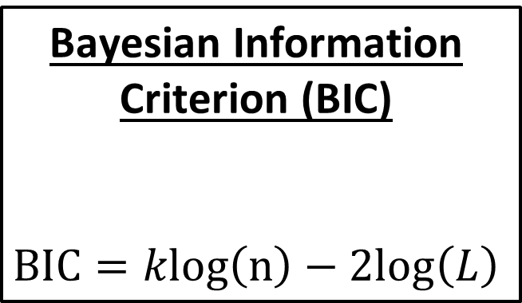
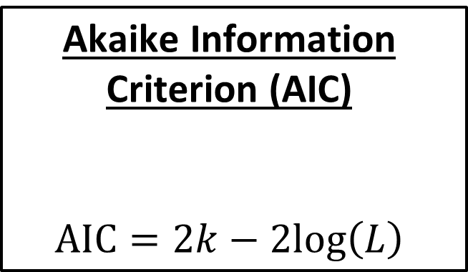
Model Information Criteria
Akaike Information Criterion (AIC) $$AIC=2k−2log⁡\left(L\right)$$
Bayesian Information Criterion (BIC) $$BIC=klog⁡\left(n\right)−2log⁡\left(L\right)$$

Slide 7
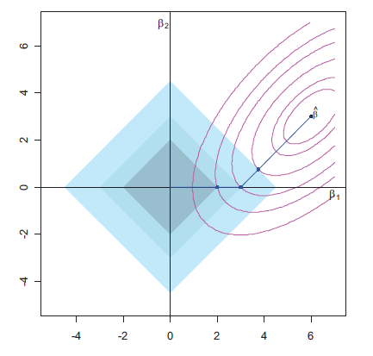
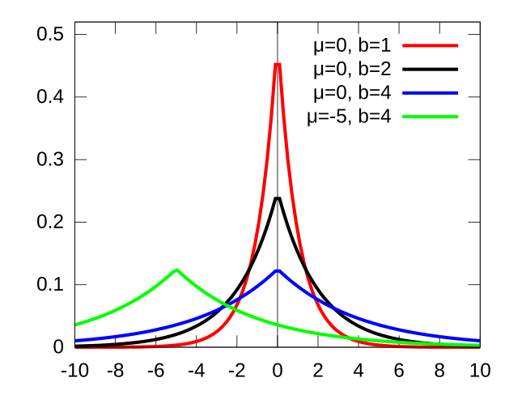
Sparsity Regularisation
LASSO
Laplace Prior

Slide 8
Occam’s Razor
“It is futile to do with more things that which can be done with fewer.”
?

Slide 9
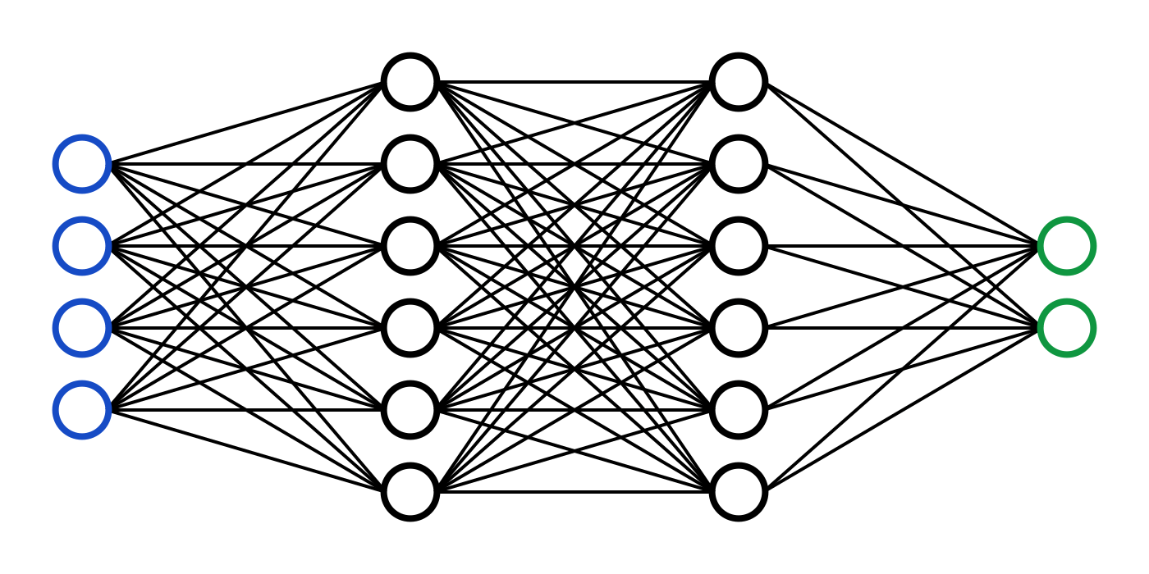
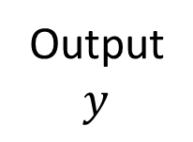
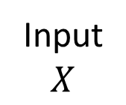
“Modern” Statistical Learning
Data
Input $$X$$
Output $$y$$

Slide 10
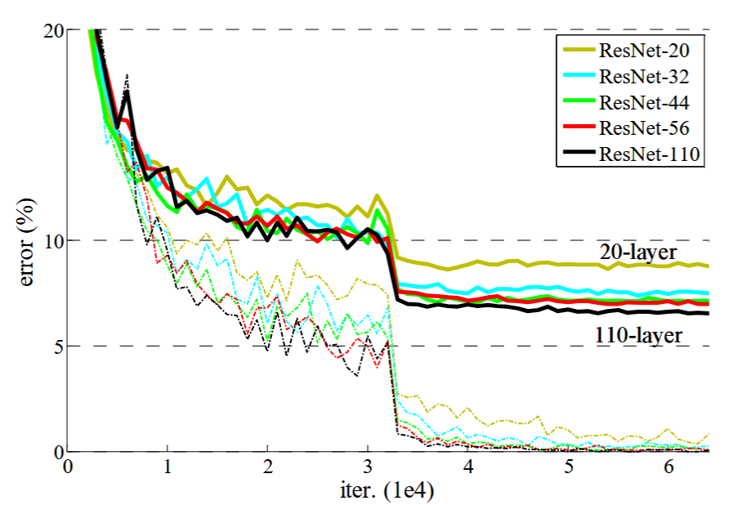
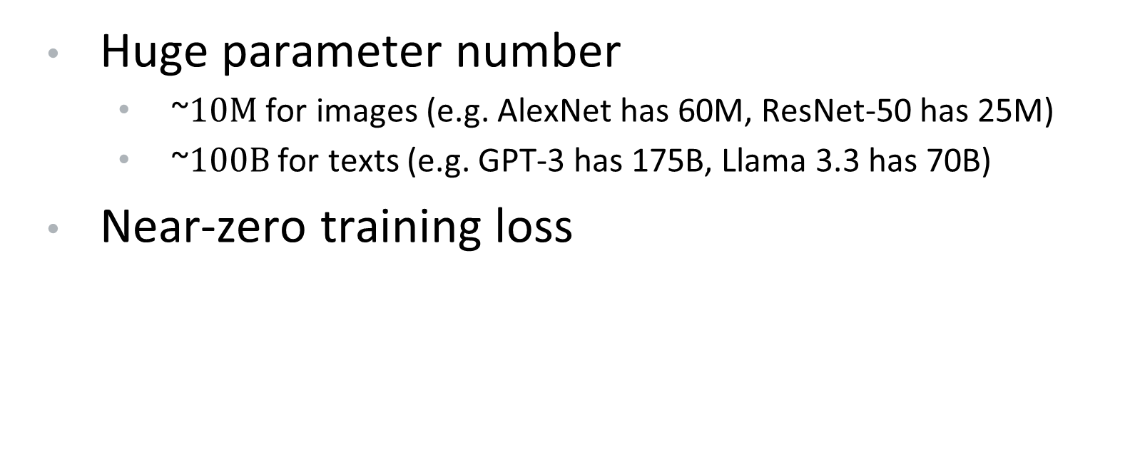
“Modern” Statistical Learning
Over-parameterisation!
Huge parameter number
~$10M$ for images (e.g. AlexNet has 60M, ResNet-50 has 25M)
~$100B$ for texts (e.g. GPT-3 has 175B, Llama 3.3 has 70B)
Near-zero training loss
Overfitting!
He, K., Zhang, X., Ren, S., & Sun, J. (2016). Deep residual learning for image recognition. In Proceedings of the IEEE conference on computer vision and pattern recognition (pp. 770-778).

Slide 11
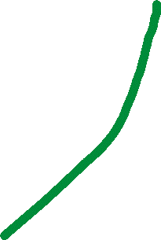
Bias-Variance Trade-off is Wrong?
Overfitting
Over-parameterisation

Slide 12
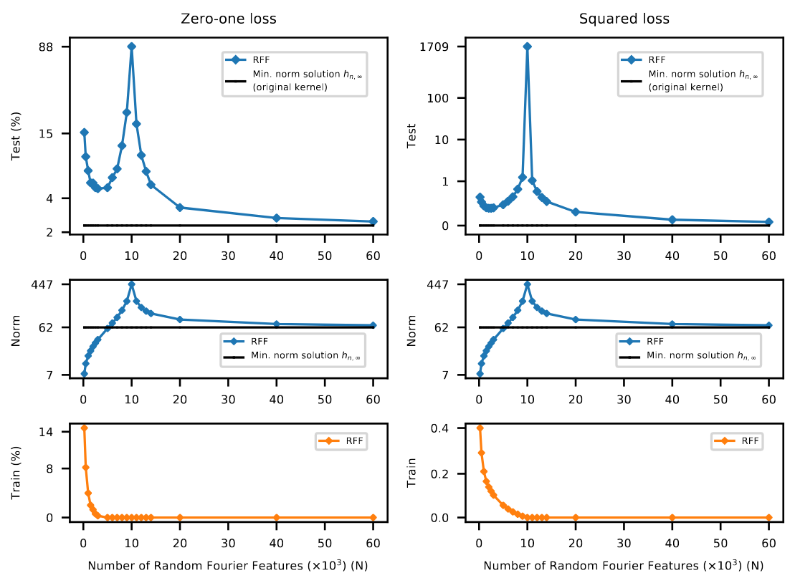
Bias-Variance Trade-off is Wrong?
Double Descent!
Belkin, Mikhail, et al. "Reconciling modern machine-learning practice and the classical bias–variance trade-off." Proceedings of the National Academy of Sciences 116.32 (2019): 15849-15854.

Slide 13
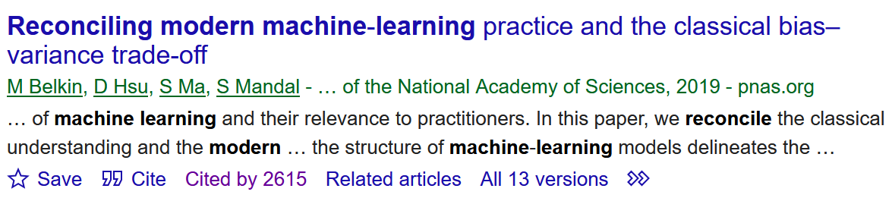
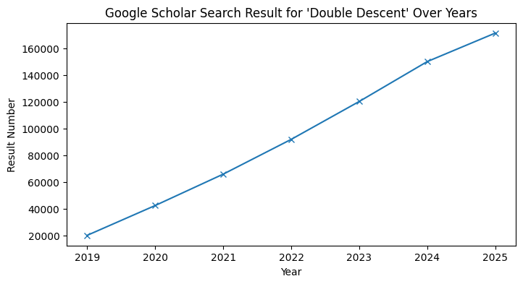
Double Descent

Slide 14
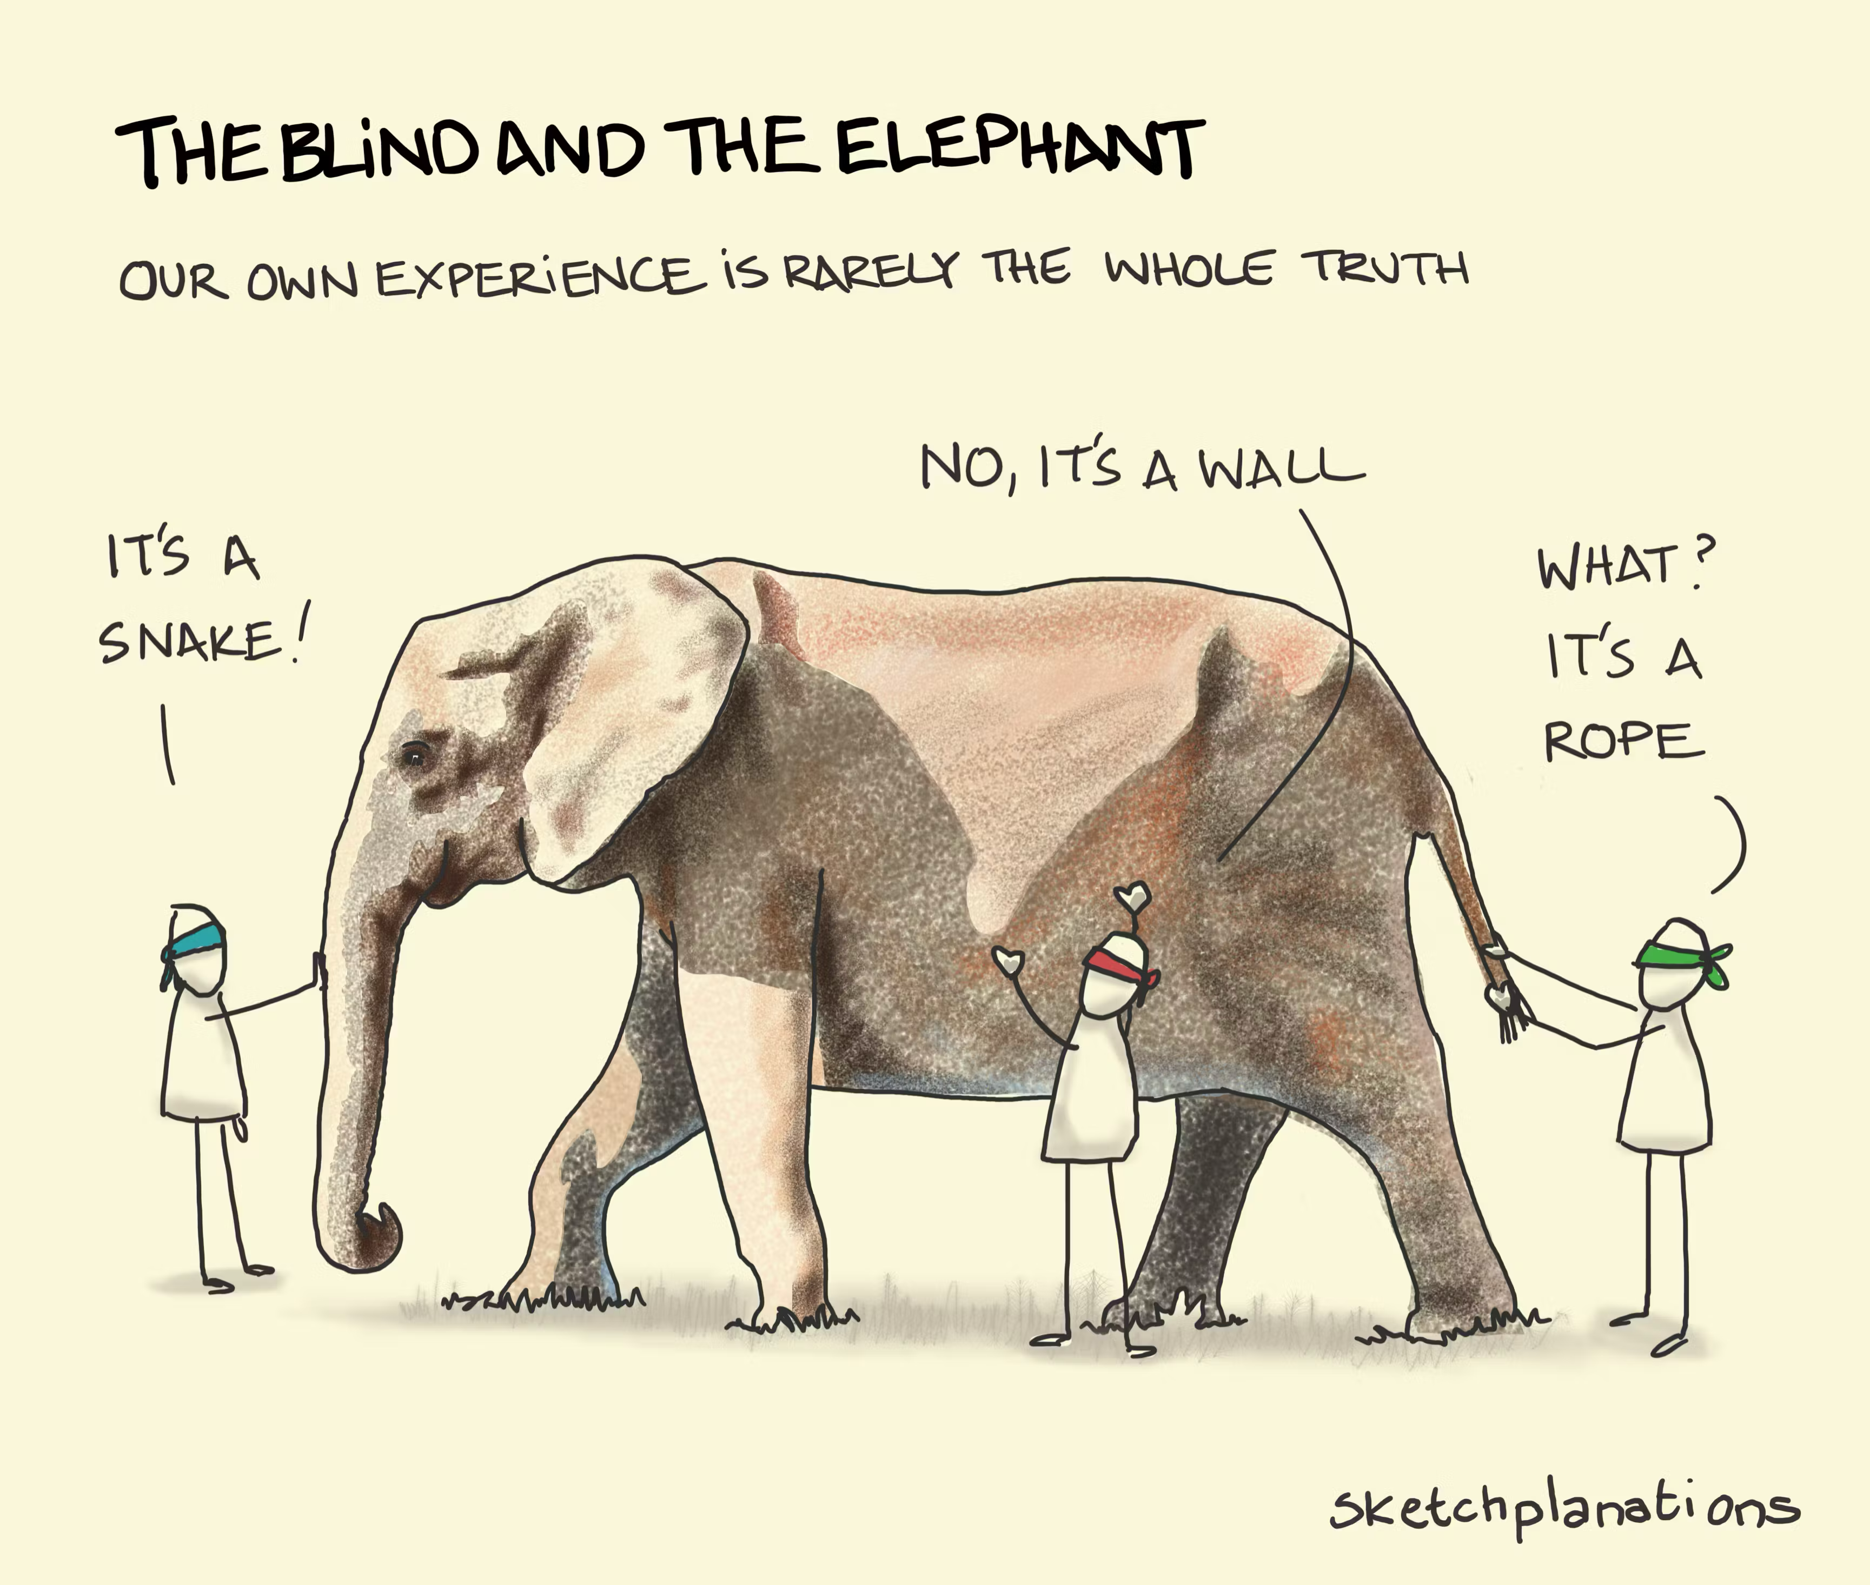

Slide 15
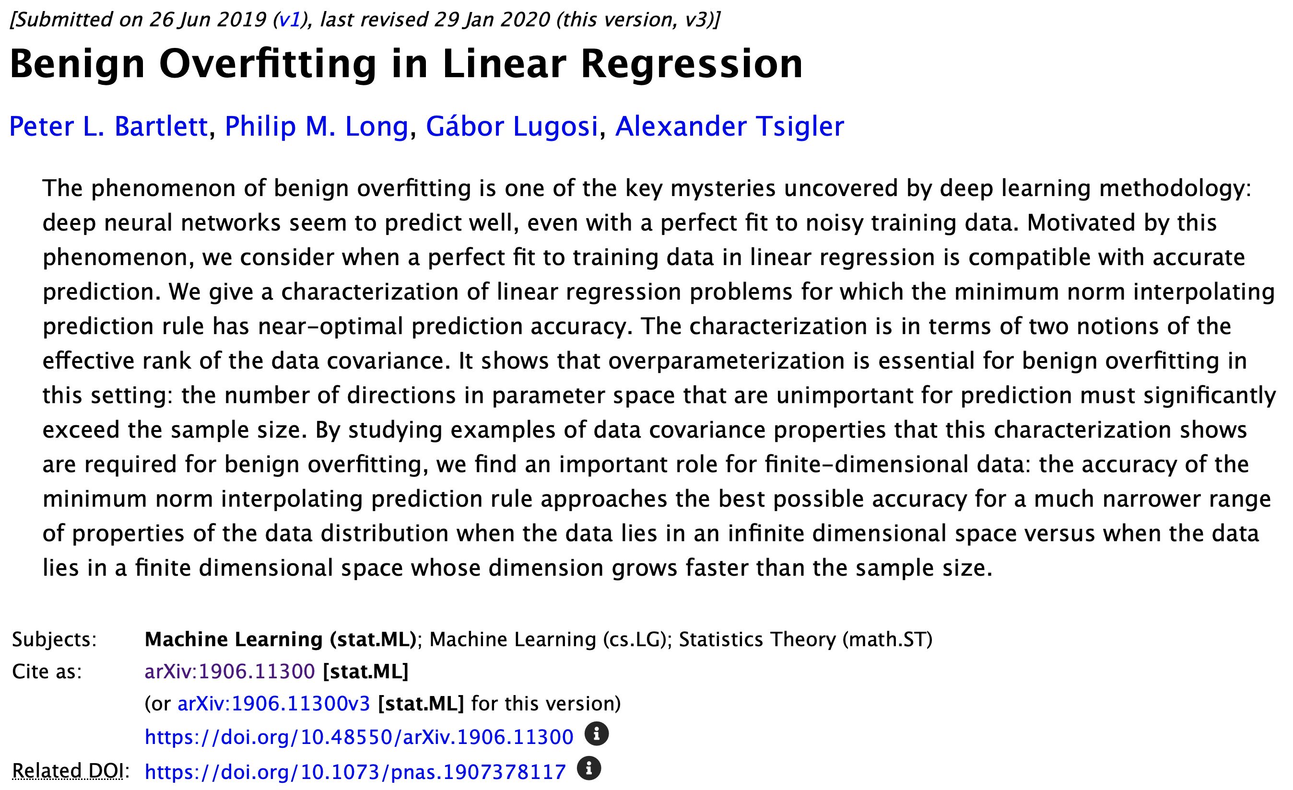
Benign Overfitting in Linear Regression

Slide 16
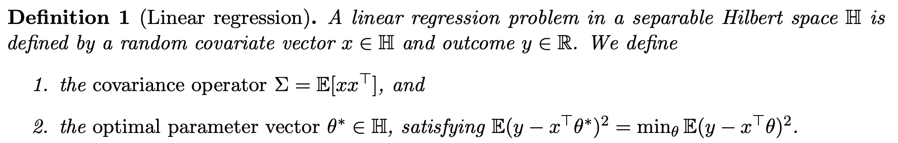
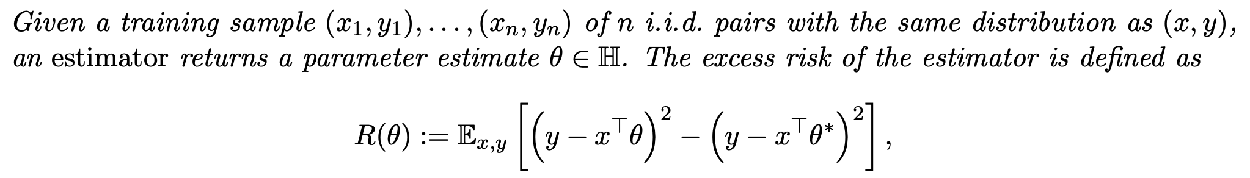
Benign Overfitting in Linear Regression

Slide 17
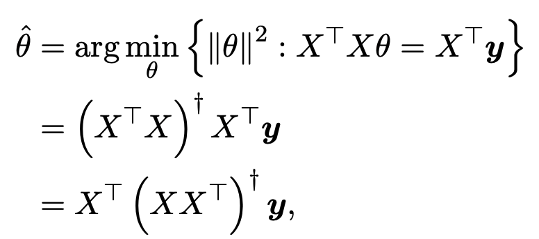
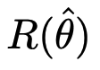
Benign Overfitting in Linear Regression

Slide 18
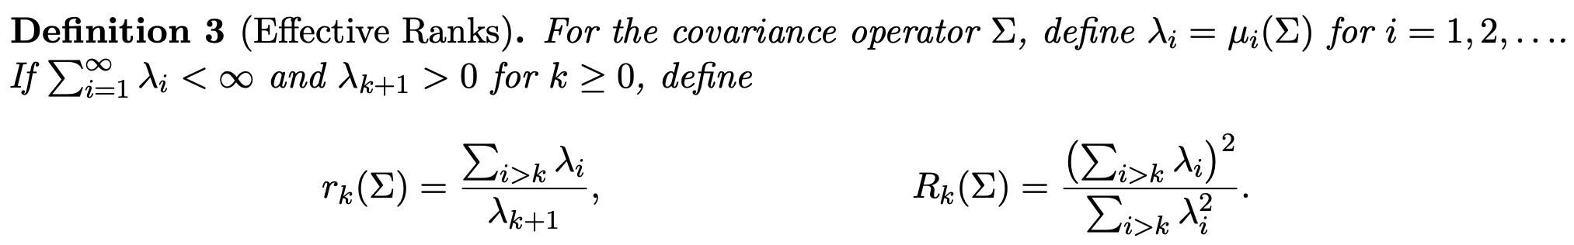
Benign Overfitting in Linear Regression
Roughly speaking, we have:
$$c_{1}\left[\frac{k^{∗}}{n}+\frac{n}{R_{k^{∗}}(Σ)}\right]≤R\left(\hat{θ}\right)≤c_{2}\left[\frac{k^{∗}}{n}+\frac{n}{R_{k^{∗}}\left(Σ\right)}\right]+c_{3}\left[\frac{r_{0}(Σ)}{n}\right]$$

Slide 19
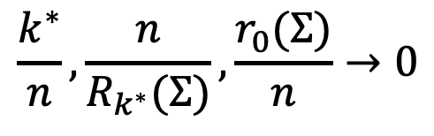
Benign Overfitting in Linear Regression
Roughly speaking, we have:
$$c_{1}\left[\frac{k^{∗}}{n}+\frac{n}{R_{k^{∗}}(Σ)}\right]≤R\left(\hat{θ}\right)≤c_{2}\left[\frac{k^{∗}}{n}+\frac{n}{R_{k^{∗}}\left(Σ\right)}\right]+c_{3}\left[\frac{r_{0}(Σ)}{n}\right]$$
$$\frac{k^{∗}}{n}, \frac{n}{R_{k^{∗}}(Σ)},\frac{r_{0}(Σ)}{n}→0$$
For benign overfitting, we want

Slide 20
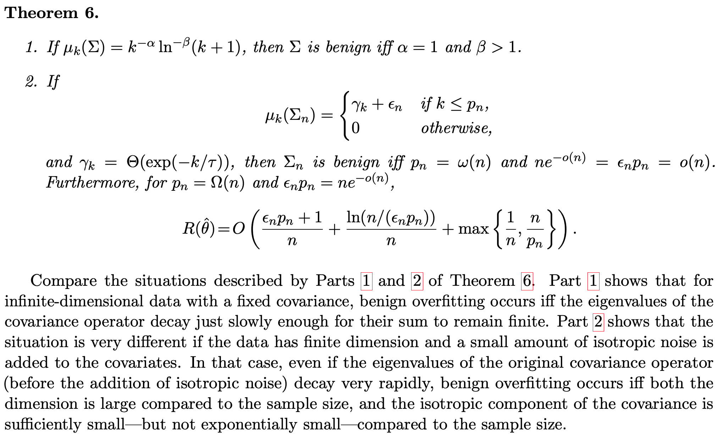
Benign Overfitting in Linear Regression

Slide 21
Benign Overfitting in Linear Regression
How do covariance eigenvalue properties translate to data properties?
Is data noise essential in practice?
How well do these results extrapolate beyond linear regression?

Slide 22
Empirical Observations and Doubts
Train till interpolation (zero train loss) is not always improving performance … sometimes early stopping in training is desirable.
The optimizer choice seems to make a difference – implicit regularization.
More data is usually better, but not always.

Slide 23
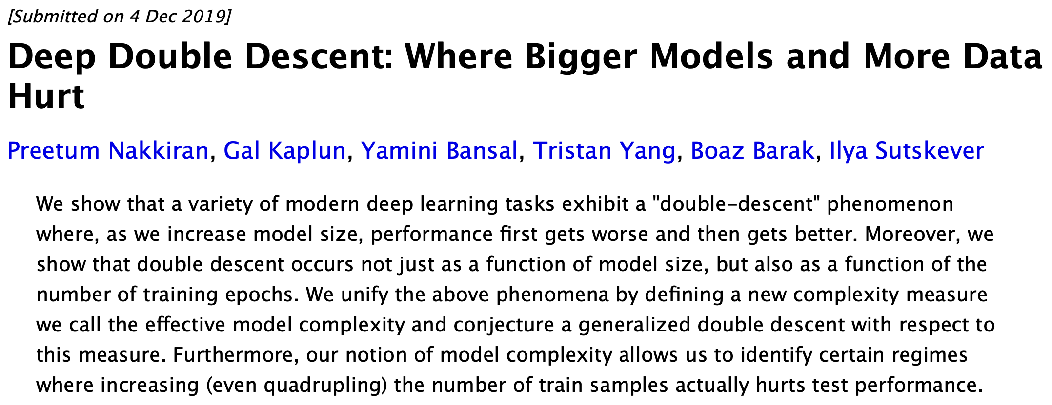
Deep Double Descent

Slide 24
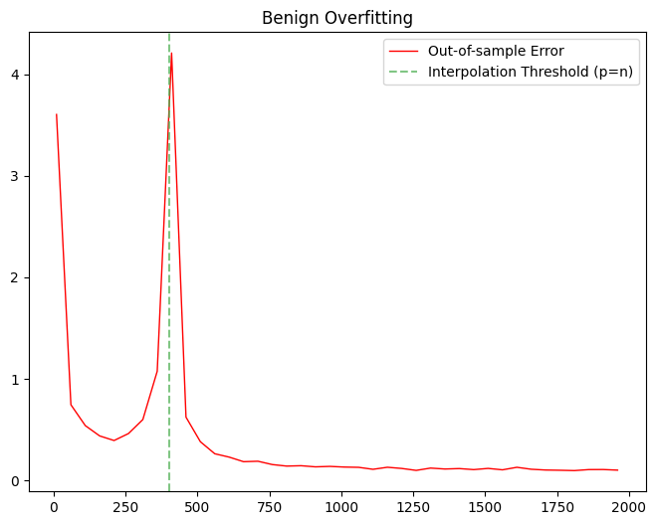
Deep Double Descent
Test Error
Effective Model Complexity
Parameter Number

Slide 25
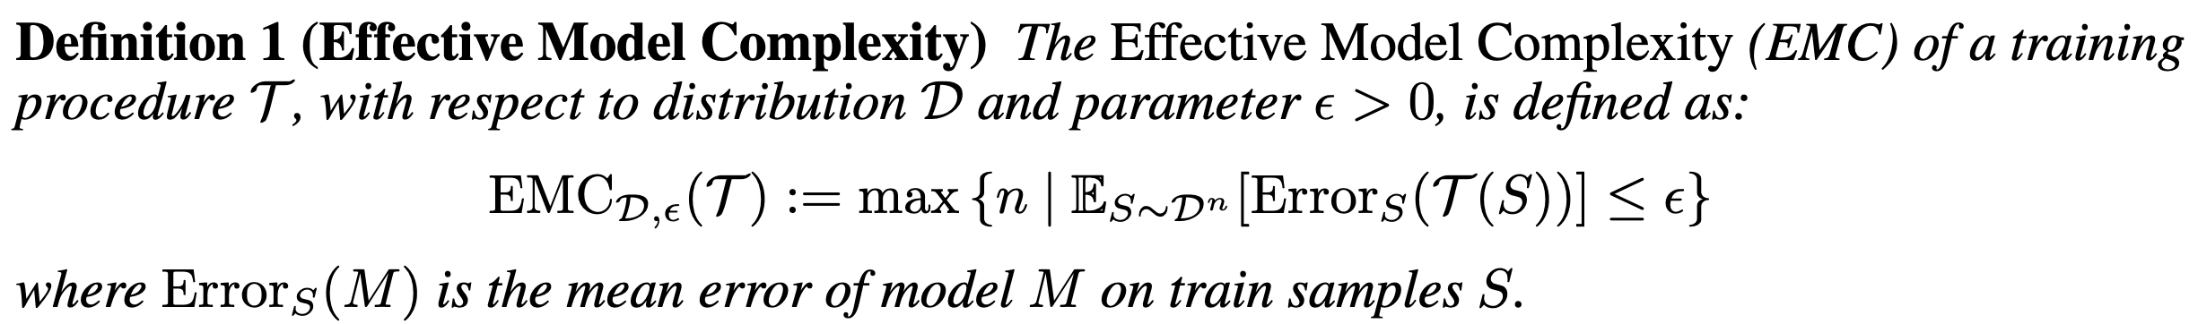
Deep Double Descent
Training procedure = Parameter Number + Optimizer + Training Time + …
e.g. linear model with L2 loss has tiny EMC (≈ 2)
One can change T in many ways …

Slide 26
Deep Double Descent
Test Error
(I)
(III)
(I) Under-Parametrised
Improve EMC always reduces test error
(II) Critically Parametrised
Improve EMC increases / reduces test error
(III) Over Parametrised
Improve EMC always reduces test error
(II)
Effective Model Complexity

Slide 27
Deep Double Descent
Changing Model Size
Changing Training Epochs
Changing Sample Number

Slide 28
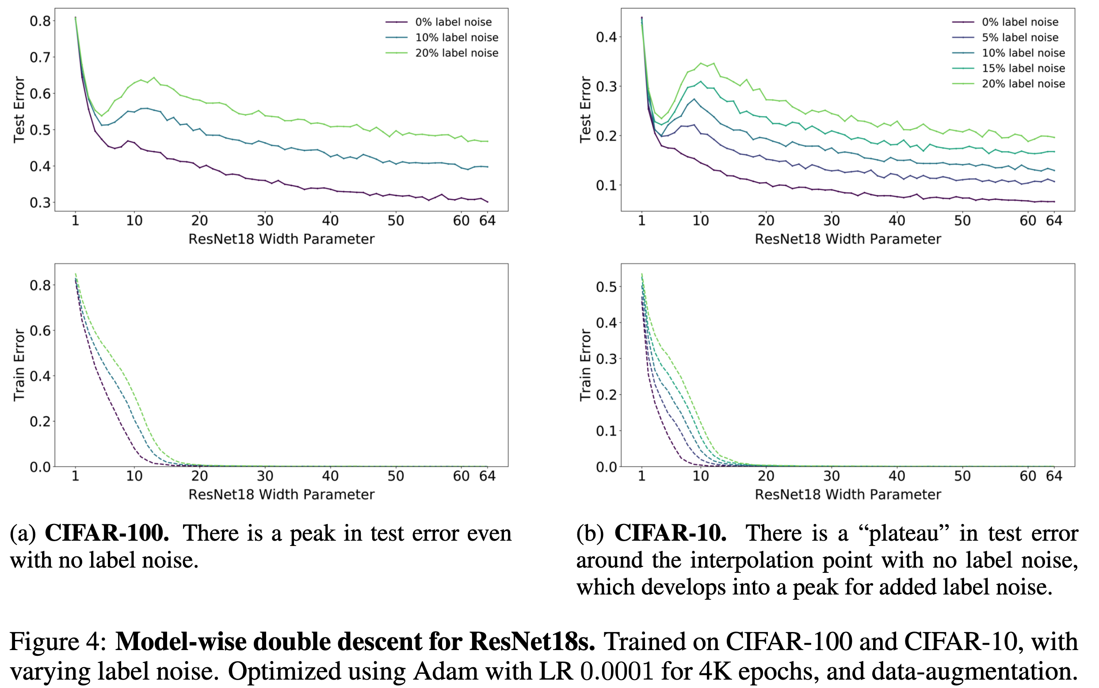
Model-Wise Double Descent

Slide 29
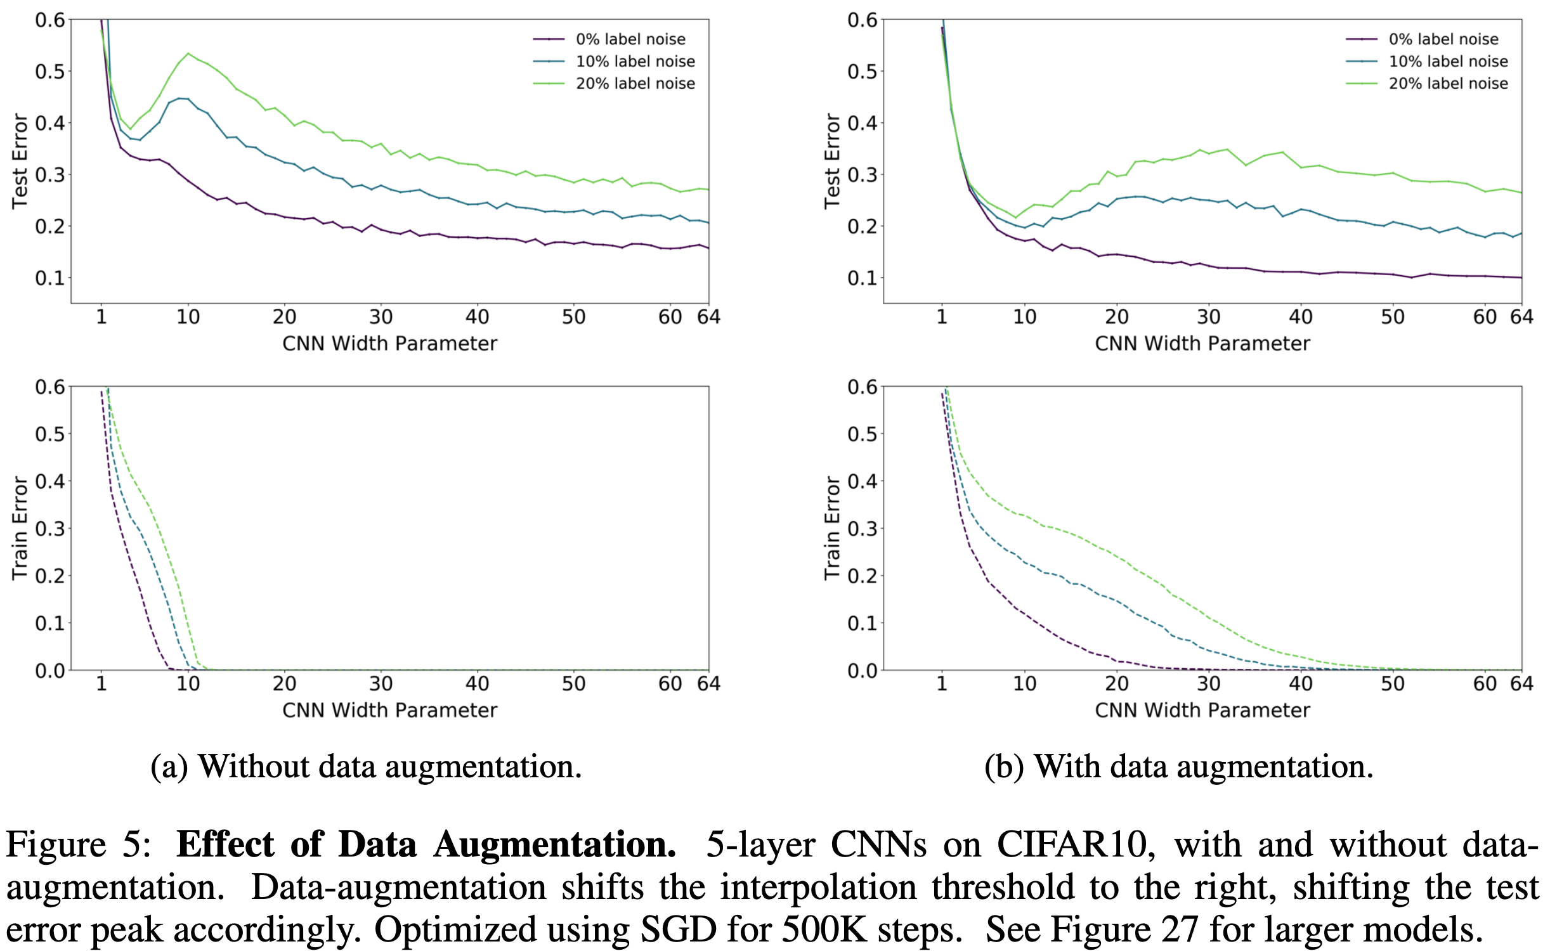
Model-Wise Double Descent

Slide 30
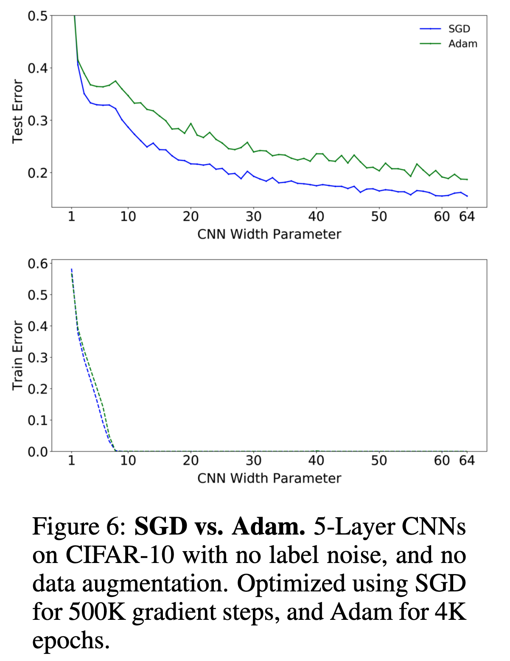
Model-Wise Double Descent

Slide 31
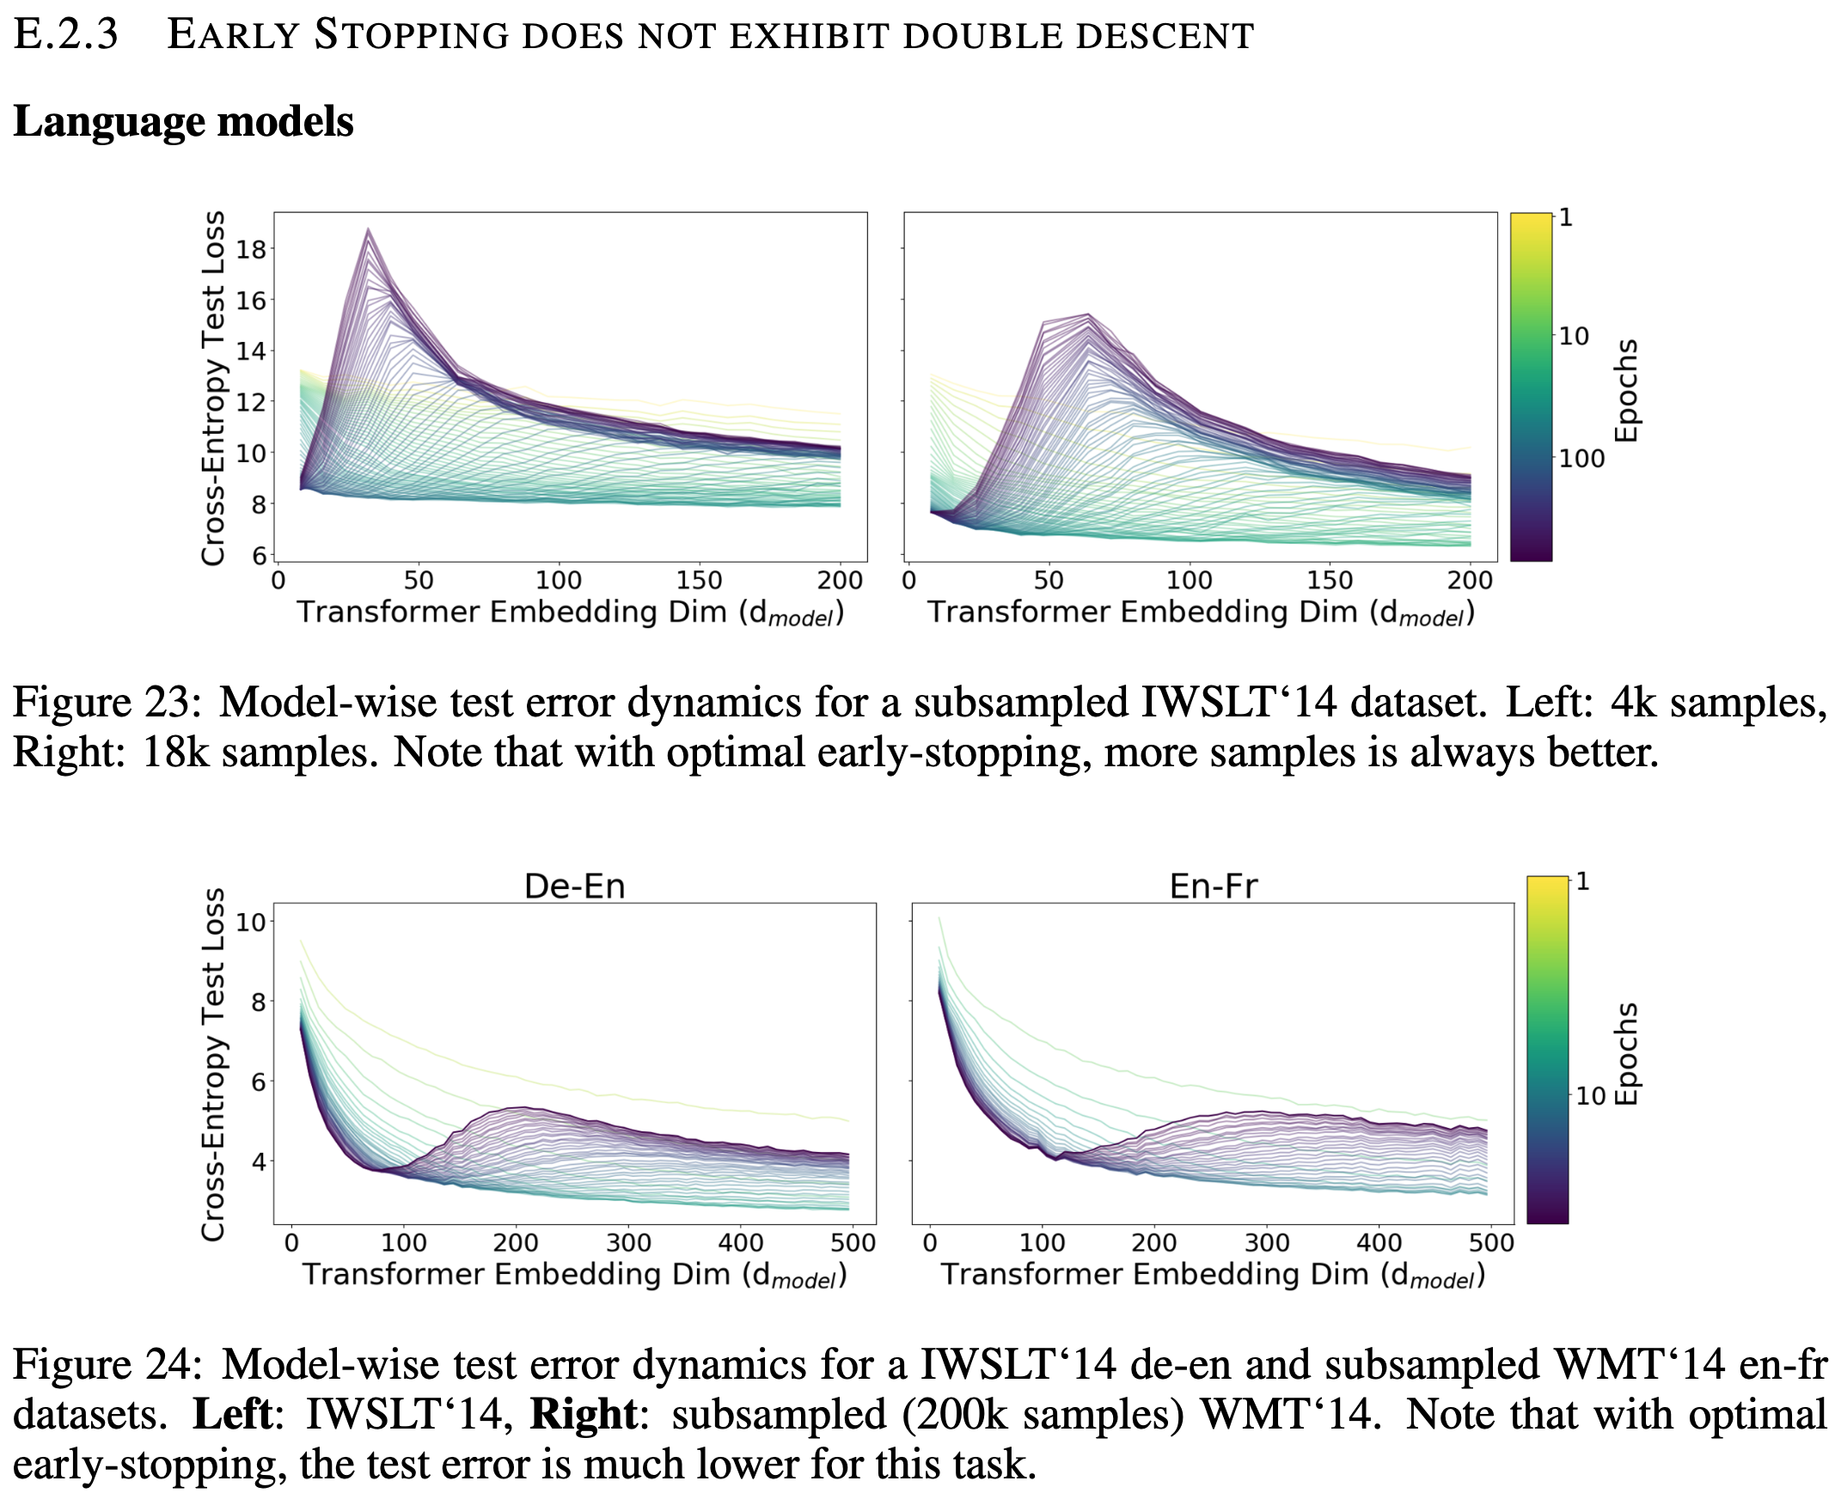
Model-Wise Double Descent

Slide 32
Model-Wise Double Descent
All modifications which increase the interpolation threshold (such as adding label noise, using data augmentation) also correspondingly shift the peak in test error towards larger models.
For model-sizes at the interpolation threshold, there is effectively only one model that fits the train data and this interpolating model is very sensitive to noise in the train set and/or model mis-specification
For over-parameterized models, there are many interpolating models that fit the train set, and SGD is able to find one that “memorizes” (or “absorbs”) the noise while still performing well on the distribution.

Slide 33
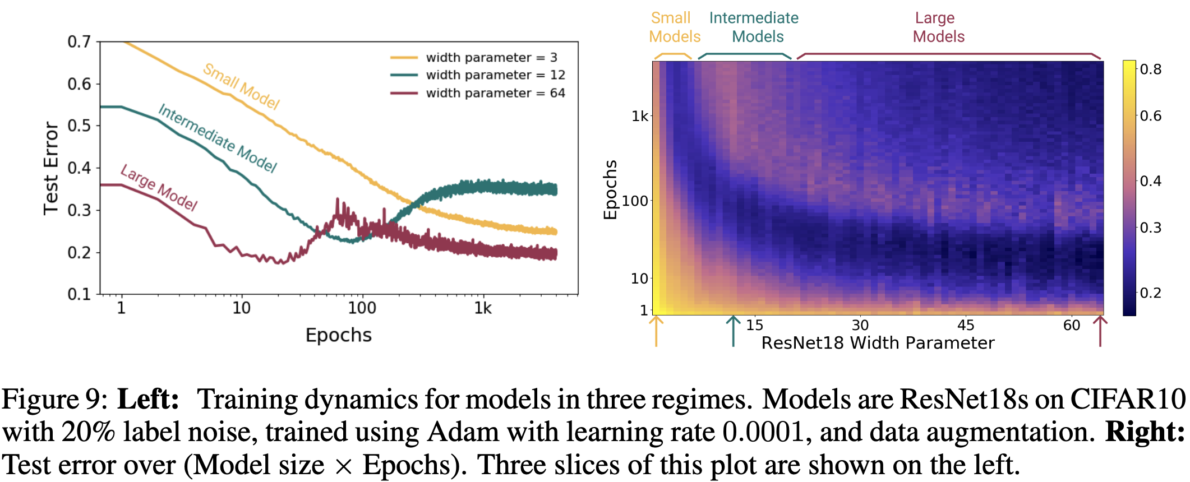
Epoch-Wise Double Descent

Slide 34
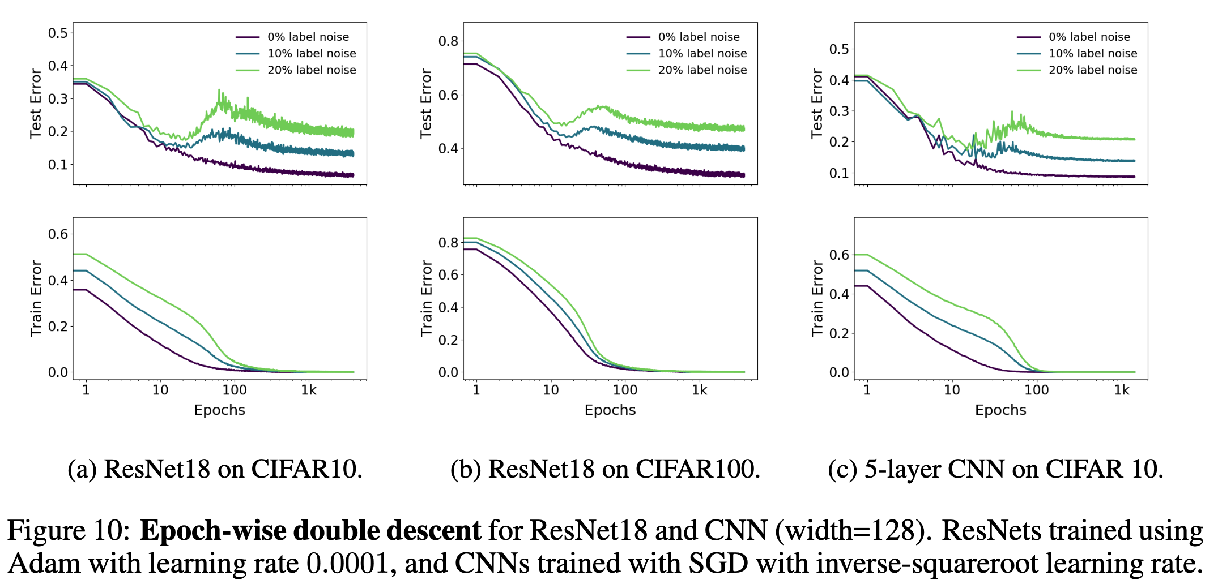
Epoch-Wise Double Descent

Slide 35
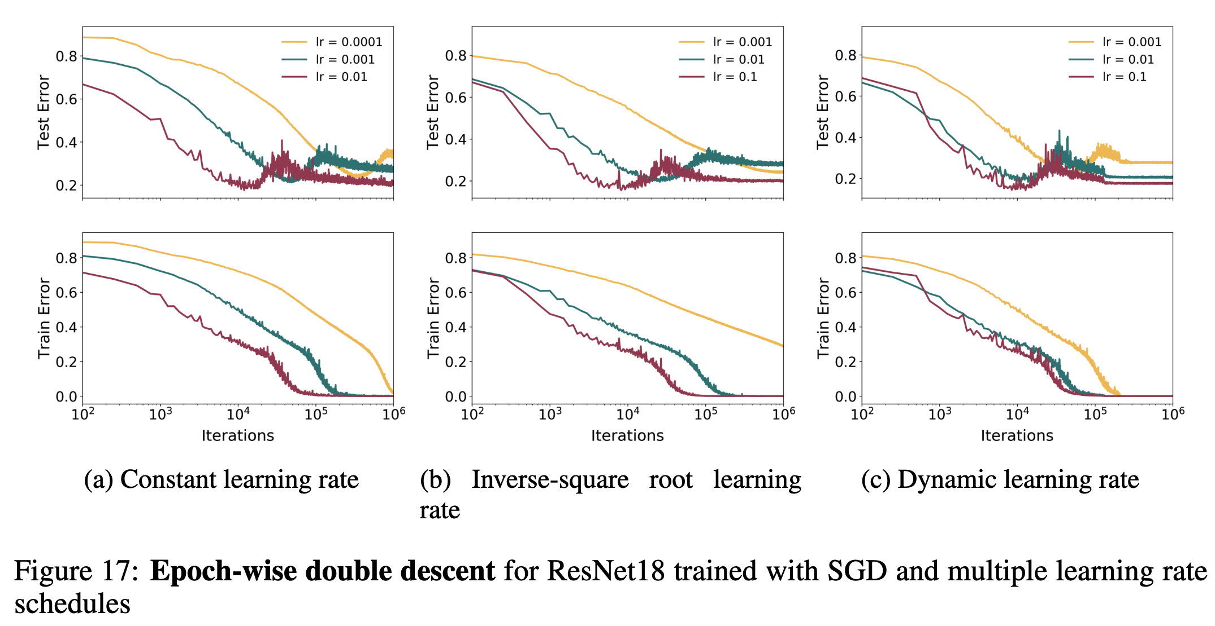
Epoch-Wise Double Descent

Slide 36
Epoch-Wise Double Descent
Sufficiently large models can undergo a “double descent” behavior where test error first decreases then increases near the interpolation threshold, and then decreases again
In contrast, for “medium sized” models, for which training to completion will only barely reach ≈ 0 error, the test error as a function of training time will follow a classical U-like curve where it is better to stop early.
Models that are too small to reach the approximation threshold will remain in the “under parameterized” regime where increasing train time monotonically decreases test error.
Further, this phenomenon is robust across optimizer variations and learning rate schedules

Slide 37
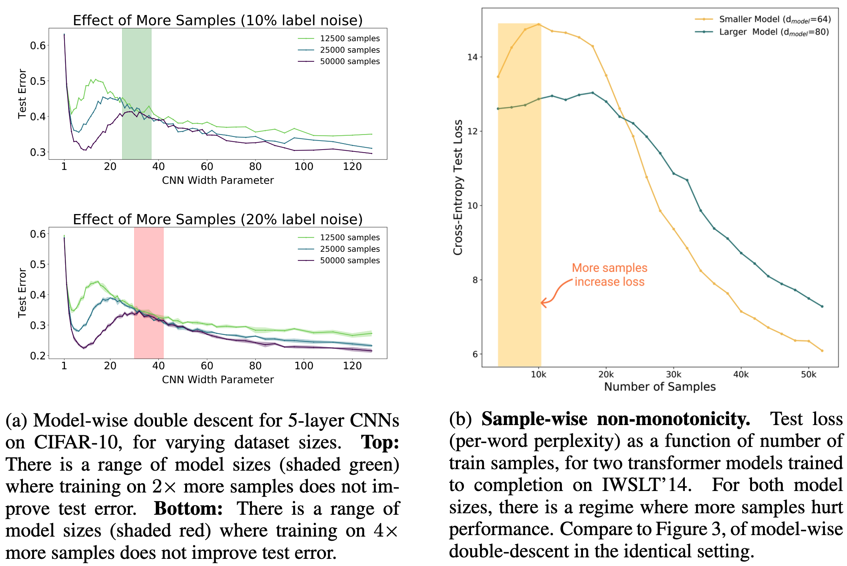
Sample-Wise Non-Monotonicity

Slide 38
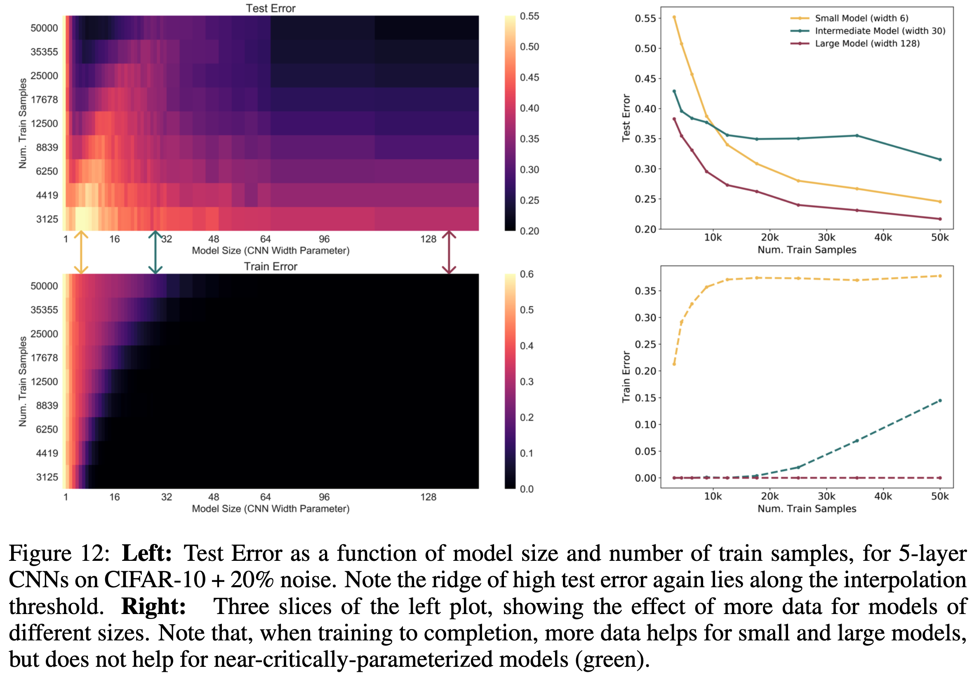
Sample-Wise Non-Monotonicity

Slide 39
Sample-Wise Non-Monotonicity
By increasing n, the same training procedure T can switch from being effectively over-parameterized to effectively under-parameterized.
On the one hand, (as expected) increasing the number of samples shrinks the area under the curve.
On the other hand, increasing the number of samples also has the effect of “shifting the curve to the right” and increasing the model complexity at which test error peaks.
There is a range of model sizes where the effects “cancel out”—and having more train samples does not help test performance when training to completion. Outside the critically-parameterized regime, for sufficiently under- or overparameterized models, having more samples helps.

Slide 40
Deep Double Descent
Test Error
(I)
(III)
(II)
Effective Model Complexity

Slide 41
Occam’s Razor
“It is futile to do with more things that which can be done with fewer.”
?

Slide 42
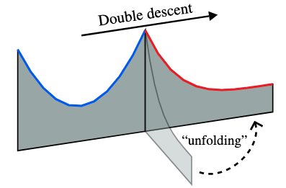
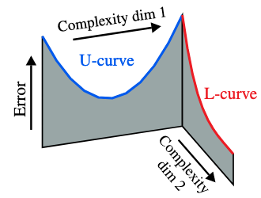
A U-turn on Double Descent

Slide 43
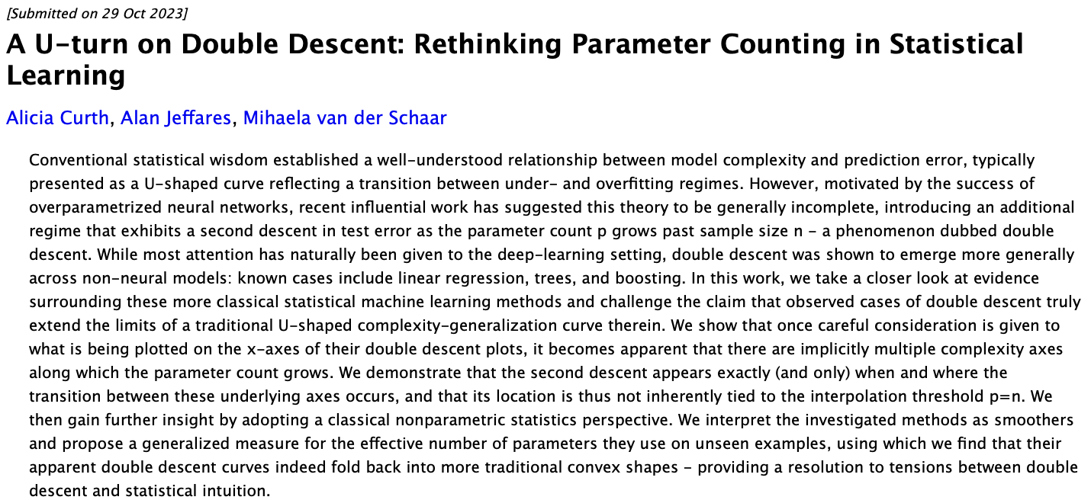
A U-turn on Double Descent

Slide 44
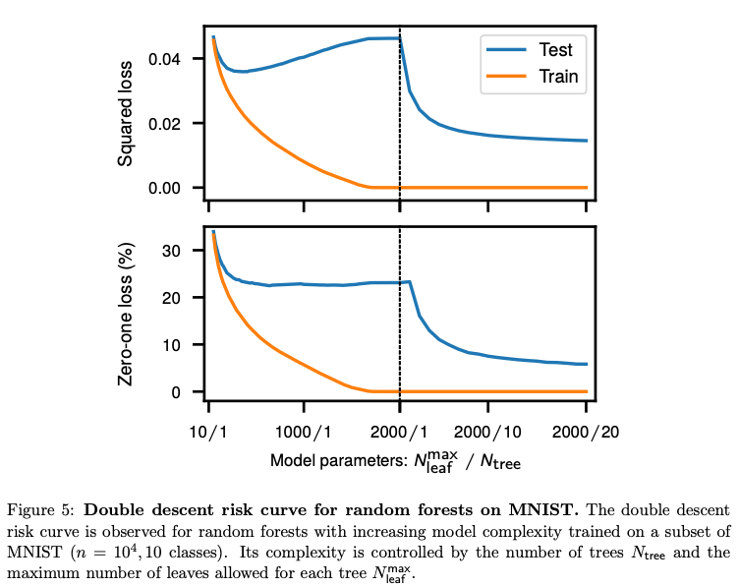
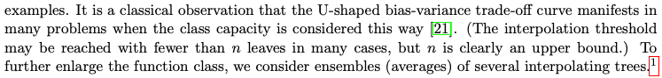
A U-turn on Double Descent
Belkin, Mikhail, et al. "Reconciling modern machine-learning practice and the classical bias–variance trade-off." Proceedings of the National Academy of Sciences 116.32 (2019): 15849-15854.
When expanding beyond n, no longer in the same model class!

Slide 45
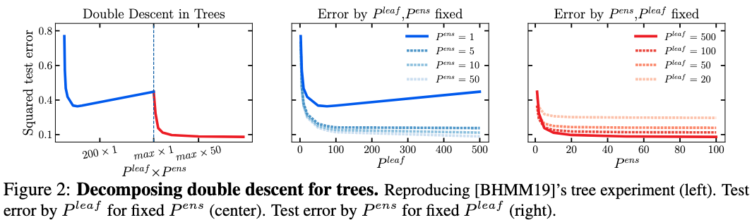
A U-turn on Double Descent

Slide 46
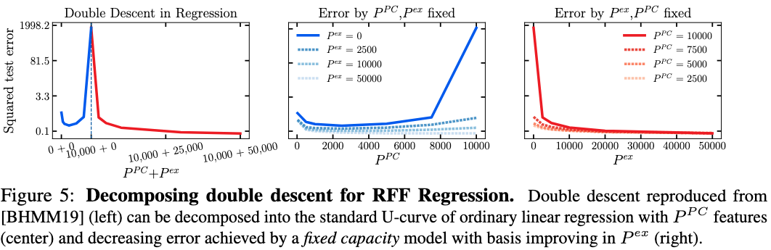
A U-turn on Double Descent

Slide 47
A U-turn on Double Descent
We demonstrated that existing experimental evidence for double descent in trees, boosting and linear regression does not contradict the traditional notion of a U-shaped complexity generalization curve.
To the contrary, there are actually two independent underlying complexity axes that each exhibit a standard convex shape, and that the observed double descent phenomenon is a direct consequence of transitioning between these two distinct mechanisms of increasing the total number of model parameters.
In the case of deep learning, … it may indeed be instructive to investigate whether there also exist multiple implicitly entangled complexity axes in neural networks, and whether this may help to explain double descent in that setting.

